Slide 1
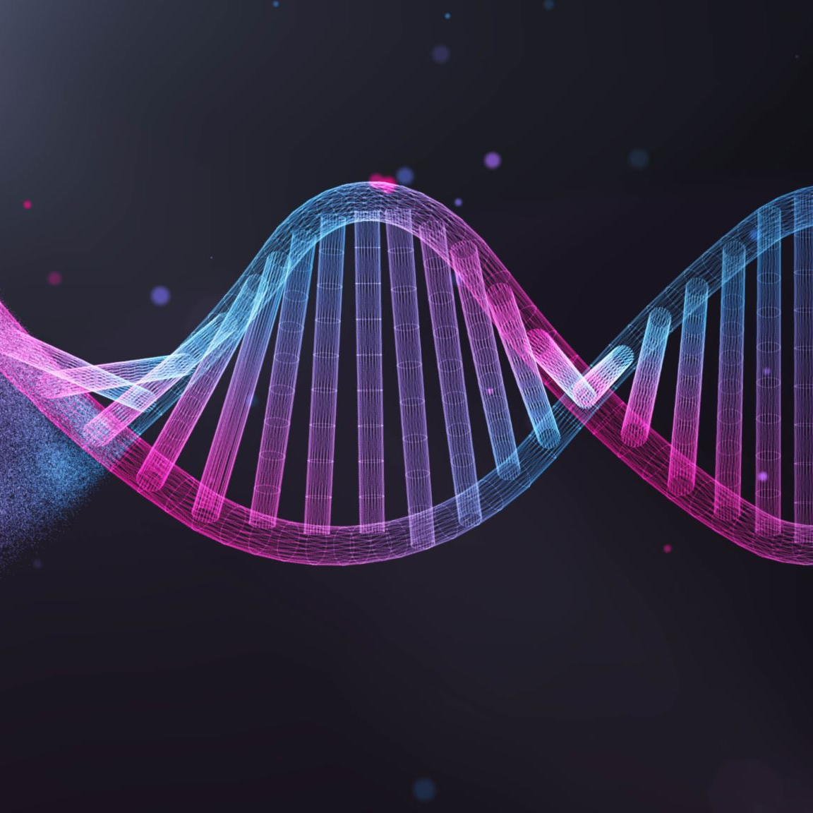
Of Genomes and Genetics
CAPSTONE PROJECT
Frances Creagh
Data Scientist

Slide 2
Agenda
A bit about me
Genes and Inheritance
The dataset
Models and results
Conclusions
Next steps
Preparing the data

Slide 3


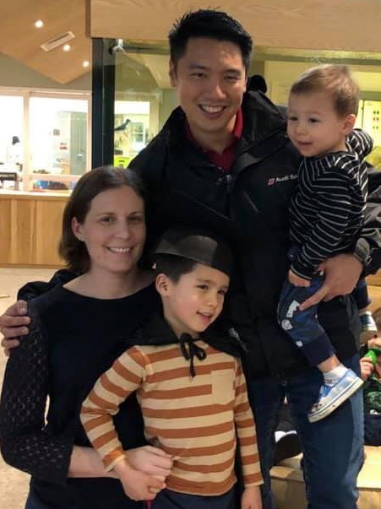


A bit about me
Notes:
Life isn’t a straight line
BSc, Biomedical Science
MSc, Genetics
PhD/LIC - 4 years work experience in big data and genetics with Livestock Improvement Corporation
EL mutations
Domain knowledge for this project topic

Slide 4
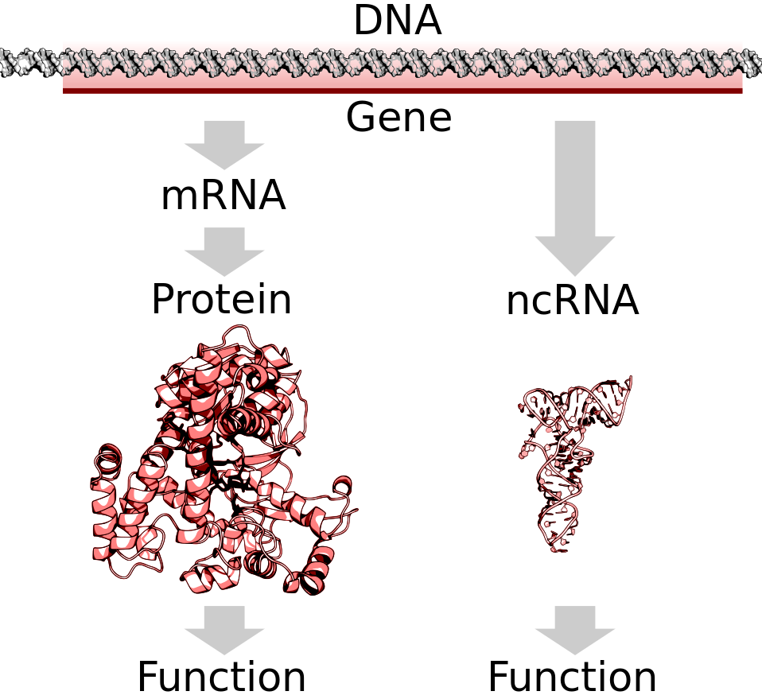
Genes and inheritance
Our body contains DNA
Inside our DNA are genes that give instructions to the body
These instructions keep our body working the right way
Some errors in these instructions make the body work the wrong way (genetic disorder)
Notes:
Similar to a very big, very complex instruction manual. If you are building a desk and follow instructions correctly and the manual is correct = correctly built desk.
If someone typed the wrong instruction = desk will be built differently – some of these differences (eg one missing screw) may not make much difference to using your desk. But some wrong instructions (putting the table top on the floor side of the legs) would make a noticeable difference and you wouldn’t be able to use your new desk.
Our body is a bit like a very complex version of this same situation.
When there is an error in the instructions that does make a difference to how the body works = then we get a genetic disorder.
Gene = part of DNA that encodes function

Slide 5
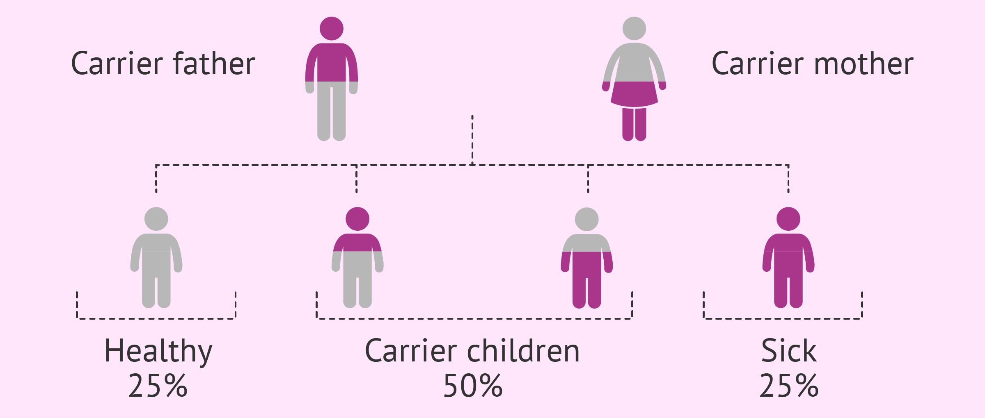
Inheritance of disease
Get 2 copies of each gene, one from each parent
Many different types of inheritance
Picture shows recessive inheritance
Need 2 copies of disease gene to get sick
Notes:
How genetic disorders get passed on varies a lot
Autosomal Recessive inheritance
2 genes – we get 1 from each parent
Trying to predict what the purple person has

Slide 6

The problem
Frequency of genetic disorders appears to be increasing as population grows
How can we diagnose these genetic disorders in order to improve patient care?
Challenges – genetic inheritance is complex:
Can inherit from 1 or both parents
Caused by single gene or multiple genes
Environmental factors also contribute
Significant previous and ongoing work in this area
Notes:
Previous work in machine learning = Kaggle notebooks
Previous work science = entire careers dedicated to finding and understanding new and existing genetic links with disease

Slide 7
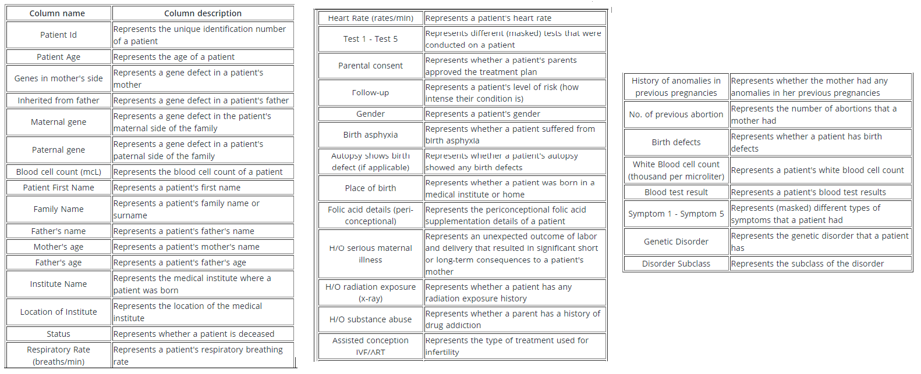
The dataset
Data from ~22,000 children with know genetic disorder.
Dataset from Kaggle – original source unknown
45 feature columns (including 2 target columns)
Predict which disorder they have based on whether the parents have (or are carriers of) the condition, symptoms and environmental contributing factors.
A highly accurate model could be used to help doctors and other medical professional with patient diagnosis and treatment.
Notes:
Business aspects
Stakeholders
Business question
Business value
Data science aspects
Data question
Data required
Data sourced
Data source, description, volume and quality
How is the data generated?
How it can be sourced in the future?

Slide 8
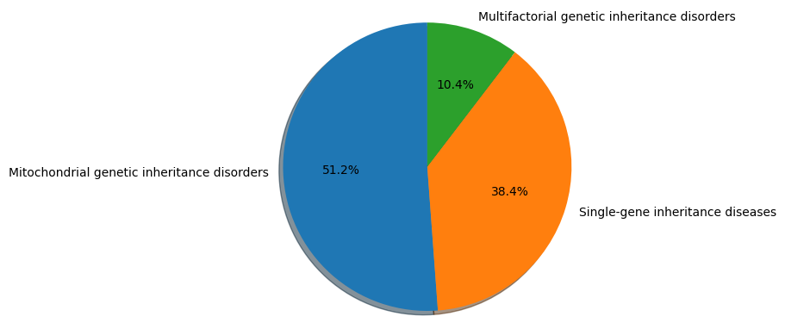
The genetic disorder (target) classes
Notes:
3 genetic disorder classes
Imbalanced – dataset was balanced to run models
Mitochondrial genetic inheritance disorders
Disease is caused by changes in the mitochondrial or nuclear DNA. Mitochondrial changes are only inherited from the mother. Nuclear DNA changes are inherited through standard inheritance pathways from either parent.
Single gene inheritance disorders
When a disease is caused by a mutation in a single gene. Different mutations in the same gene can lead to the same disease.
Multifactorial genetic inheritance disorders
Conditions caused by many contributing factors. They are influenced by multiple genes (polygenic) as well as lifestyle and environmental factors.

Slide 9
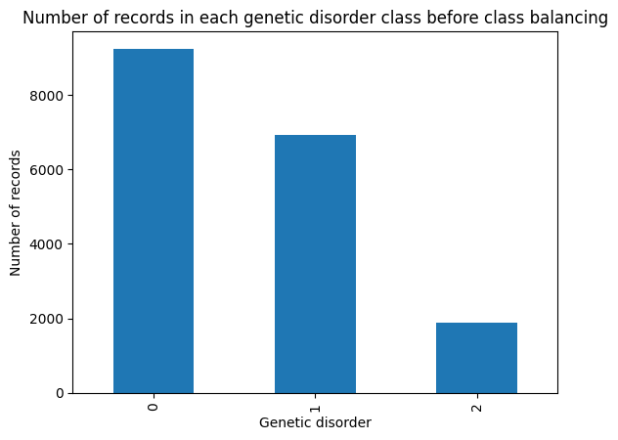
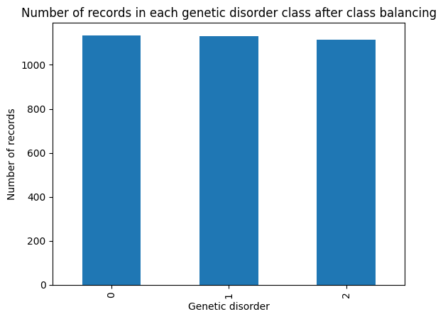
Preparing the data
Fill in missing values with median or mode
Encoding the character features to numeric
Balance the dataset for the 3 classes by reducing the majority classes
Feature selection to choose best features
Notes:
The data needed some preparation for machine learning.

Slide 10
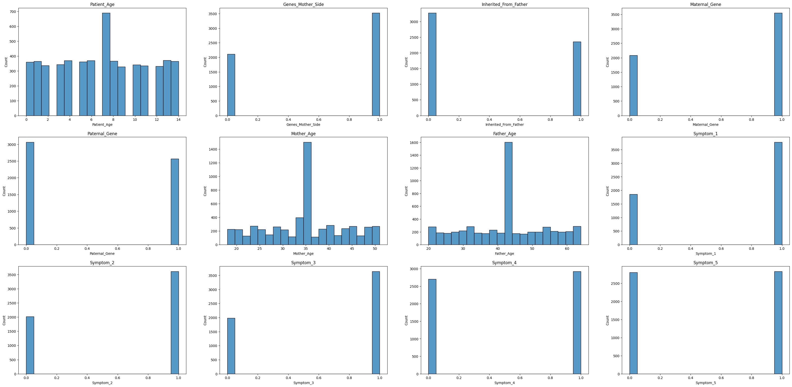
12 best features selected:
Patient age
Maternal gene
Paternal gene
Inherited from father
Genes mother’s side
Mother age
Father age
Symptoms 1-5
Notes:
12 best chosen using chi2 in sklearn – choose the 12 with the highest chisq score = higher means more statistically signif assoc between the variables
Do the mother or father or someone on the mother or fathers side of the family have a gene defect?
Mostly categorial features
Selected features are ones that would be very relevant to the question at hand
Maternal gene = gene defect in the patient’s maternal family side
Paternal gene = gene defect in the patient’s paternal family side
Inherited from father = whether the father has a known gene defect
Gene’s mothers side = defect in gene in patients mother

Slide 11

Models
Model | Result
Logistic regression | 0.555
K-Nearest Neighbors | 0.667
Support Vector Machine | 0.705
Stacking model | 0.597
Neural network | 0.600
5 Machine Learning models were tried
Notes:
Logistic regression
KNN
SVM
Stacking model – KNN, random forest, naïve bayes – logistic regression meta model
Neural network – 3 hidden layers plus output layer

Slide 12
Conclusions
The accuracy achieved by these models appears better than random guessing but needs further improvement for medical diagnosis.
Support Vector Machine model looks most promising at this stage
Predicting the inheritance of genetic disorder is a complex problem
This creates challenges with developing accurate machine learning models
If a highly accurate model can be developed it could be used as a tool by medical professionals in the diagnosis and treatment of patients.

Slide 13
Next steps
Try SMOTE to impute minority classes
Investigate whether further features could be added to the model to improve predictions: - Include genome sequence data (complex) - More symptoms information
Try further models.
Notes:
Other models
XGBOOST,
Boosting
Bagging
Adding genome sequence data is best option but also very complex

Slide 14
Questions?

Slide 15
appendices
1) https://matplotlib.org/stable/api/_as_gen/matplotlib.pyplot.subplots_adjust.html 2) https://stackoverflow.com/questions/49199164/increasing-pie-chart-size-with-matplotlib-radius-parameter-appears-to-do-nothin 3) https://matplotlib.org/3.1.1/api/text_api.html 4) https://www.kaggle.com/code/brsdincer/genomes-and-genetics-disorder-eda-process-i 5) https://towardsdatascience.com/how-to-drop-rows-in-pandas-dataframes-with-nan-values-in-certain-columns-7613ad1a7f25 6) https://www.analyticsvidhya.com/blog/2021/04/beginners-guide-to-missing-value-ratio-and-its-implementation/ 7) https://datascience.stackexchange.com/questions/15135/train-test-validation-set-splitting-in-sklearn 8) https://towardsdatascience.com/hyperparameter-tuning-with-grid-search-and-random-search-6e1b5e175144 9) https://scikit-learn.org/stable/modules/generated/sklearn.linear_model.LogisticRegression.html 10) https://scikit-learn.org/stable/modules/svm.html 11) https://scikit-learn.org/stable/modules/generated/sklearn.neighbors.KNeighborsClassifier.html 12) https://scikit-learn.org/stable/modules/svm.html 13) https://towardsdatascience.com/comprehensive-guide-on-multiclass-classification-metrics-af94cfb83fbd 14) https://stackoverflow.com/questions/39828535/how-to-tune-gaussiannb 15) https://towardsdatascience.com/simple-model-stacking-explained-and-automated-1b54e4357916 16) https://scikit-learn.org/stable/modules/generated/sklearn.ensemble.StackingClassifier.html 17) https://imbalanced-learn.org/stable/under_sampling.html 18) https://scikit-learn.org/stable/modules/generated/sklearn.feature_selection.chi2.html 19) https://towardsdatascience.com/assumptions-of-logistic-regression-clearly-explained-44d85a22b290 20) https://www.kdnuggets.com/2021/02/machine-learning-assumptions.html 21) https://towardsdatascience.com/machine-learning-basics-with-the-k-nearest-neighbors-algorithm-6a6e71d01761 22) https://towardsdatascience.com/a-practical-guide-to-stacking-using-scikit-learn-91e8d021863d 23) https://www.reddit.com/r/learnmachinelearning/comments/9m561w/how_do_i_accurately_understand_a_neural_network/

Slide 16
Domain knowledge:
https://www.ncbi.nlm.nih.gov/books/NBK115561/ https://www.genomicseducation.hee.nhs.uk/documents/inheritance-and-genetic-conditions/ https://pubmed.ncbi.nlm.nih.gov/31424543/ https://rarediseases.info.nih.gov/diseases/7048/mitochondrial-genetic-disorders https://www.ncbi.nlm.nih.gov/books/NBK132154/ https://medlineplus.gov/genetics/understanding/mutationsanddisorders/complexdisorders/
https://en.wikipedia.org/wiki/Gene

